Slide 1
Student Placement Salary Analysis
Group 3: Nafisa Aurny, Uzayr Chaudhry, David Mwaria, Ruth Picazo
7 May 2026

Slide 2
Student Placement Salary Analysis
Agenda
Introduction
Data Cleaning
Data Analysis
Conclusion

Slide 3
Introduction
Student Placement Salary Analysis
Source: Kaggle
Original dataset: 10,000 observations, 13 variables
Modeling dataset: 6,153 placed students
Removed placement_status from modeling data
No missing values / no duplicates in cleaned analysis dataset
Research question:
Which student-related factors best explain salary among students who received job placements?

Slide 4
Dataset and Cleaning Approach
Student Placement Salary Analysis
Original Data → Placed Students Only → Remove placement_status → Final Regression Dataset
Original dataset:
10,000 observations, 13 variables
Steps:
1. Filtered to placement_status = "Placed"
2. Removed placement_status after filtering
3. Checked for missing values and duplicates
4. Converted categorical predictors into factors
5. Final modeling dataset: 6,153 placed students
Why this matters:
Unplaced students had salary = 0, so including them would mix placement prediction with salary prediction.

Slide 5
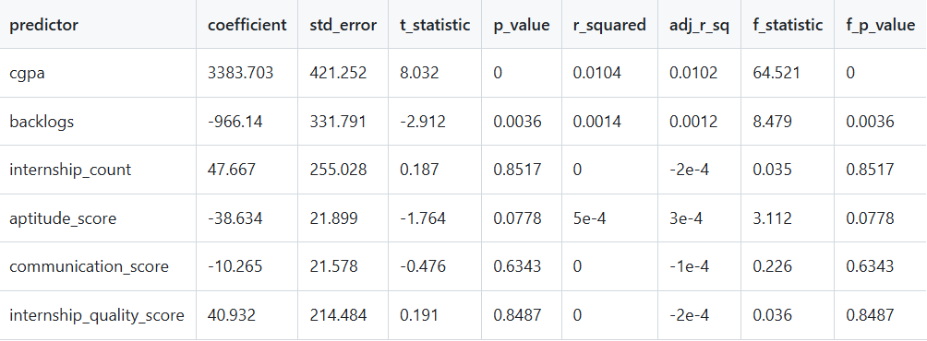
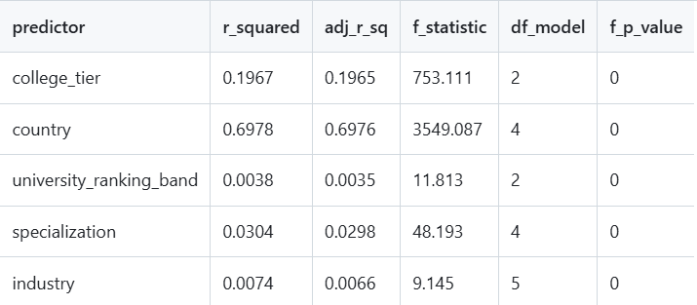
Response and Predictor Variables
Student Placement Salary Analysis
Response Variable
salary
Numeric Predictors
Categorical Predictors
(factored)
cgpa backlogs internship_count aptitude_score communication_score internship_quality_score
College_tier
Country
University_ranking_band
Specialization
industry

Slide 6
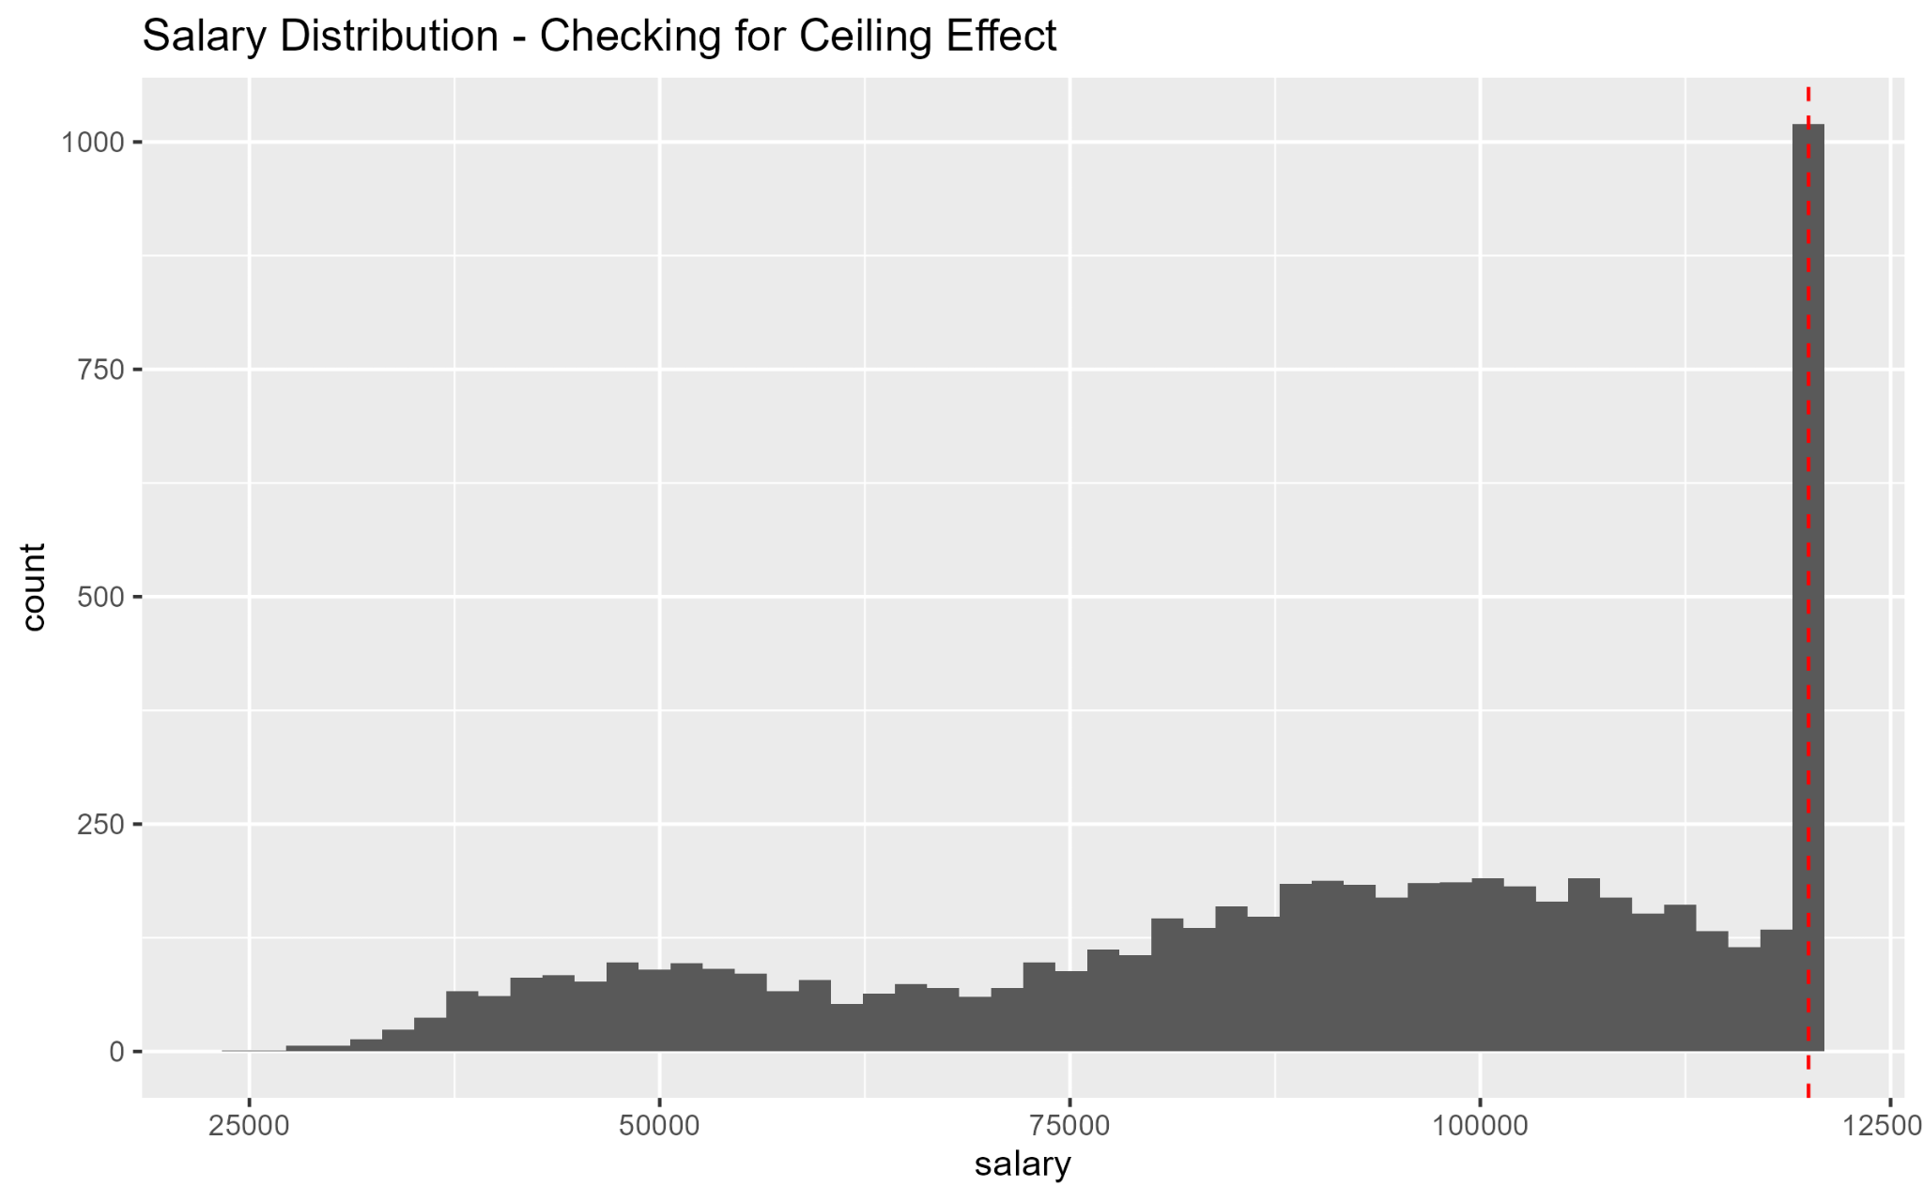
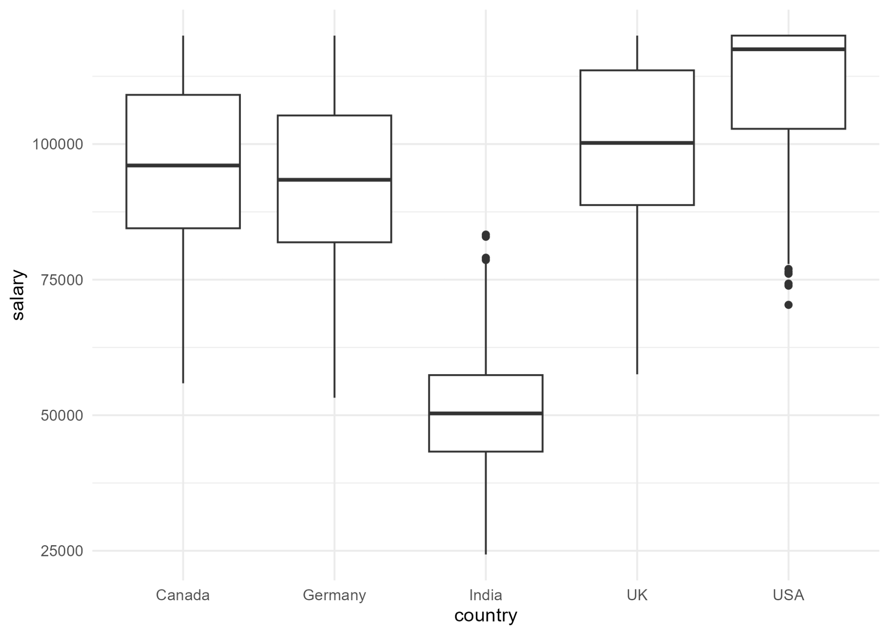
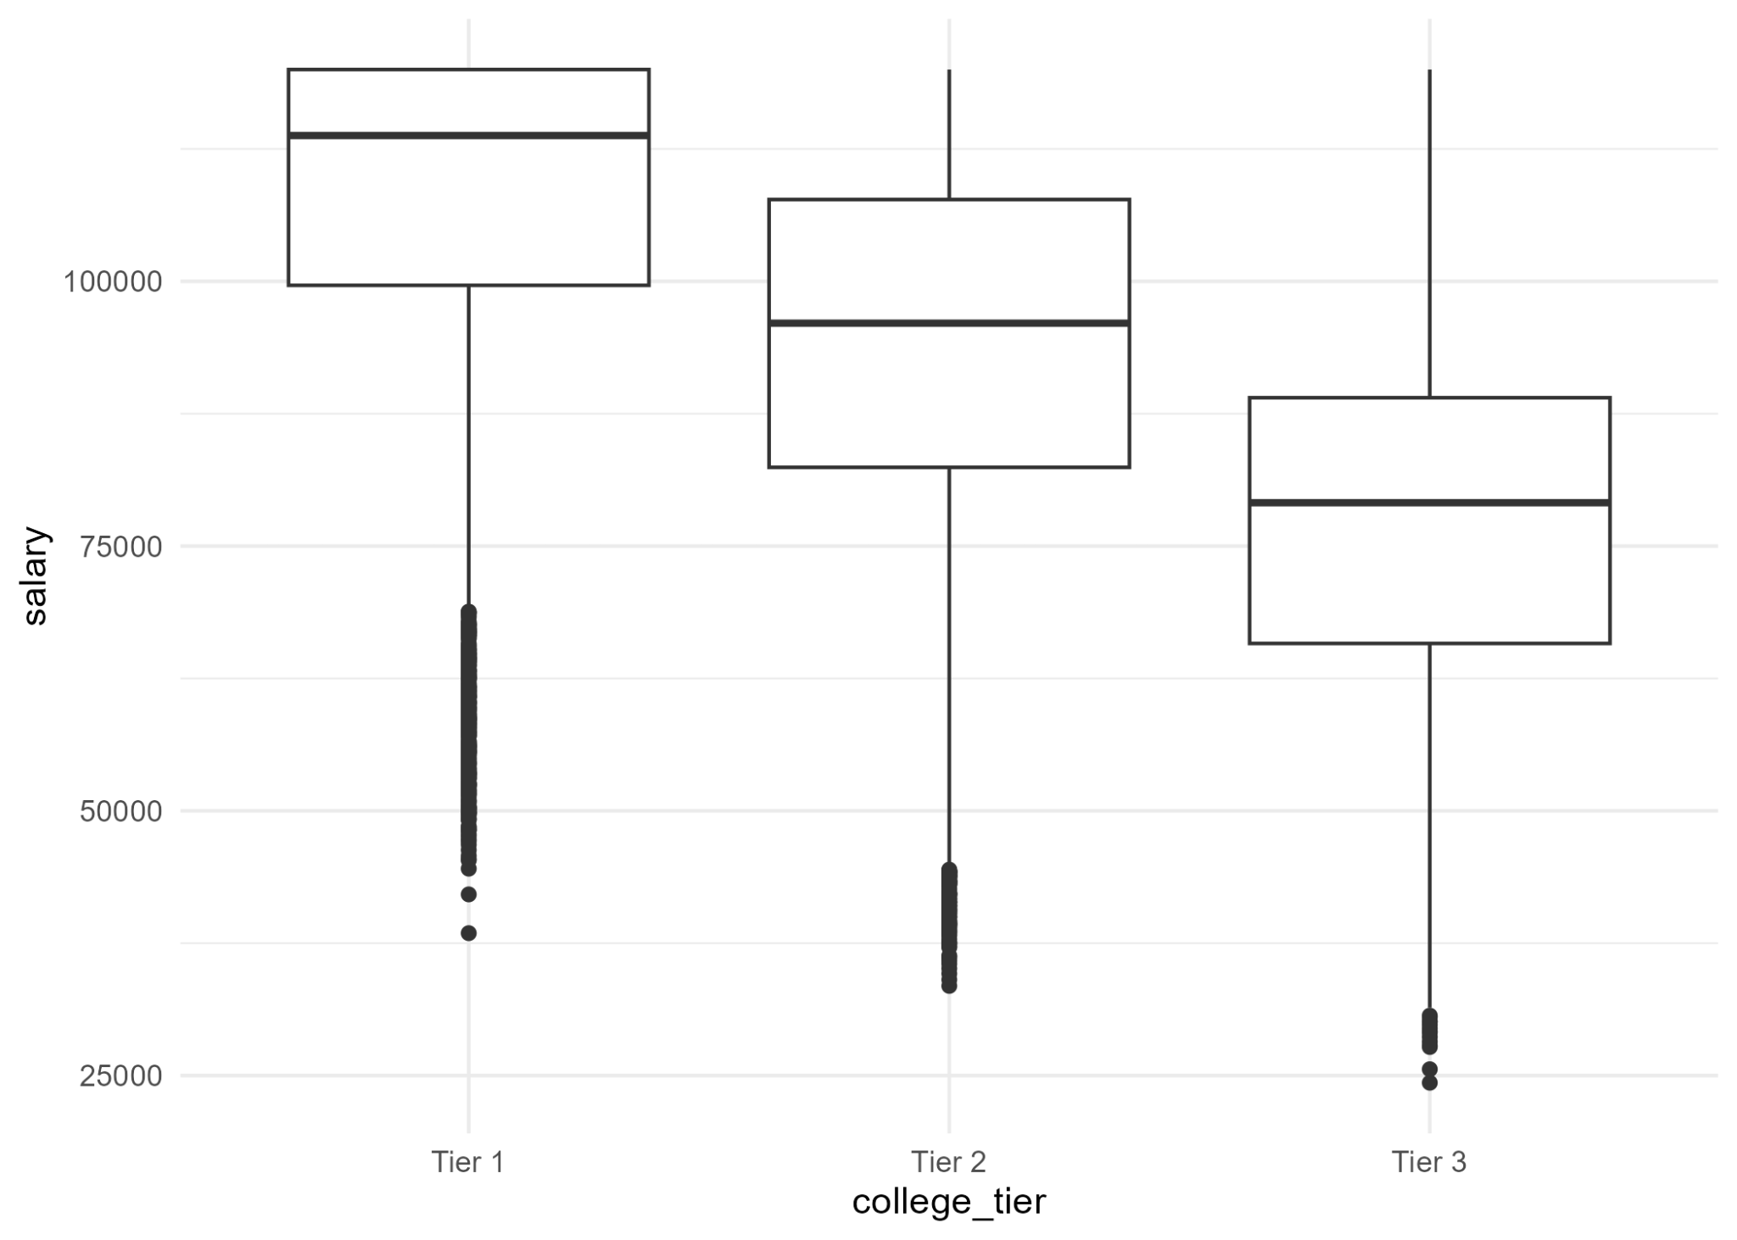
Exploratory Data Analysis
Student Placement Salary Analysis
Key Observations:
- Salary is capped at 120,000
- Salary varies significantly by country
- Salary varies by college tier
- Weak linear relationship with most numeric predictors
Distribution of Salary for Placed students
Salary by Country
Salary by College Tier

Slide 7
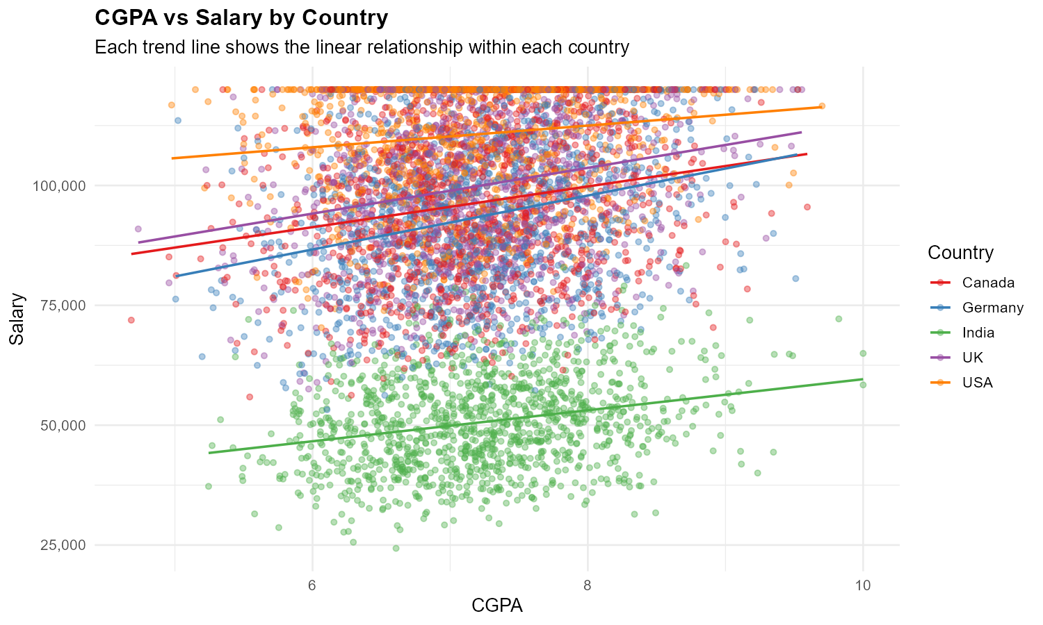
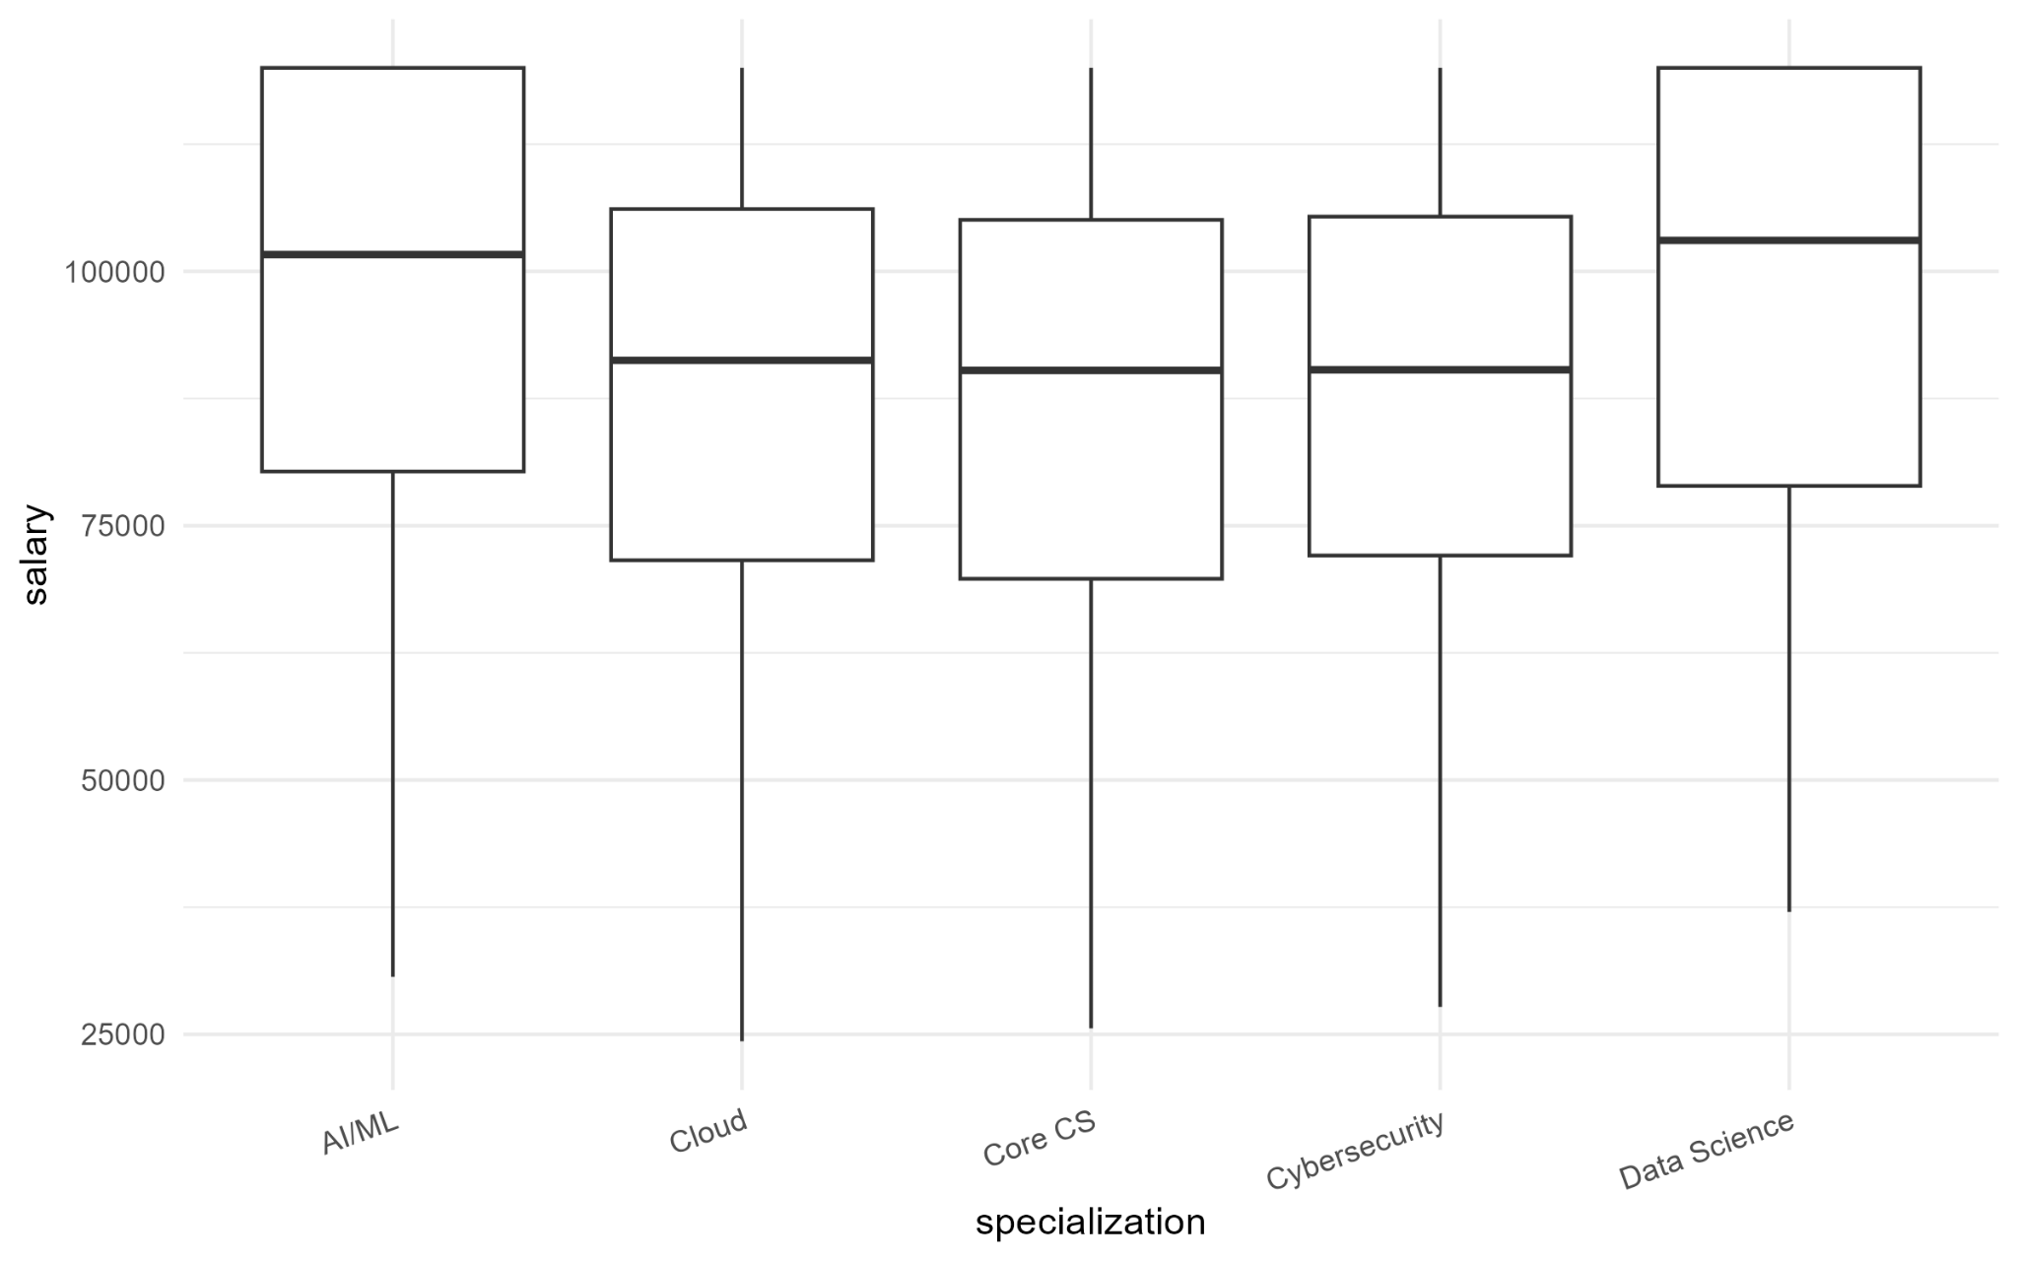
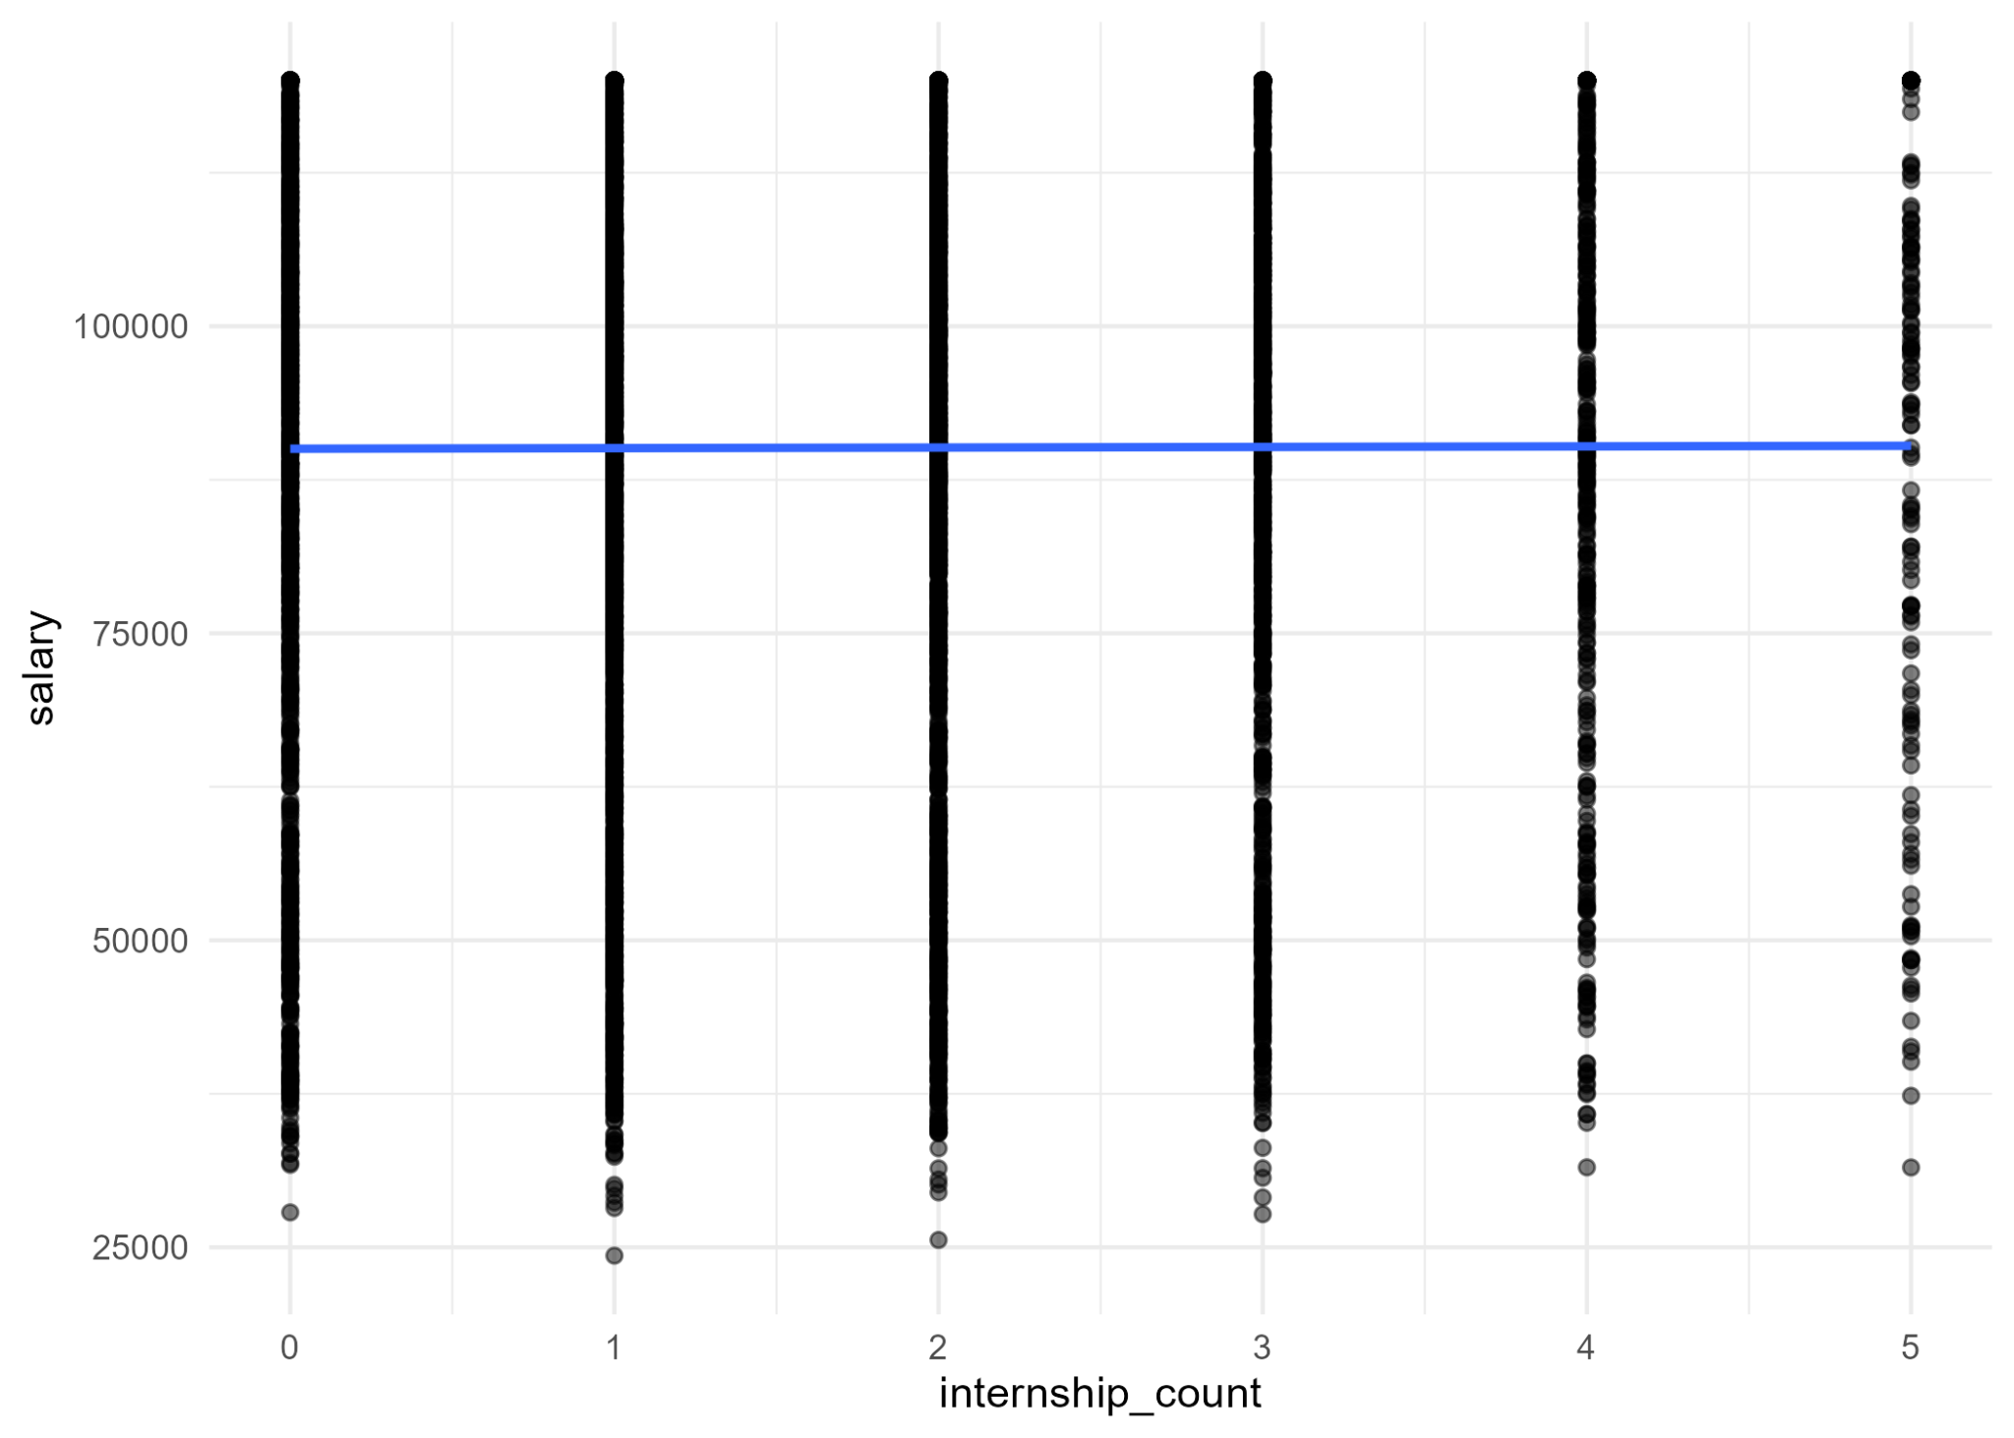
Exploratory Data Analysis
Student Placement Salary Analysis
Key Observations:
- Salary is capped at 120,000
- Salary varies significantly by country
- Salary varies by college tier
- Weak linear relationship with most numeric predictors
CGPA vs Salary by Country
Salary by Specialization
Salary vs Internship Count

Slide 8
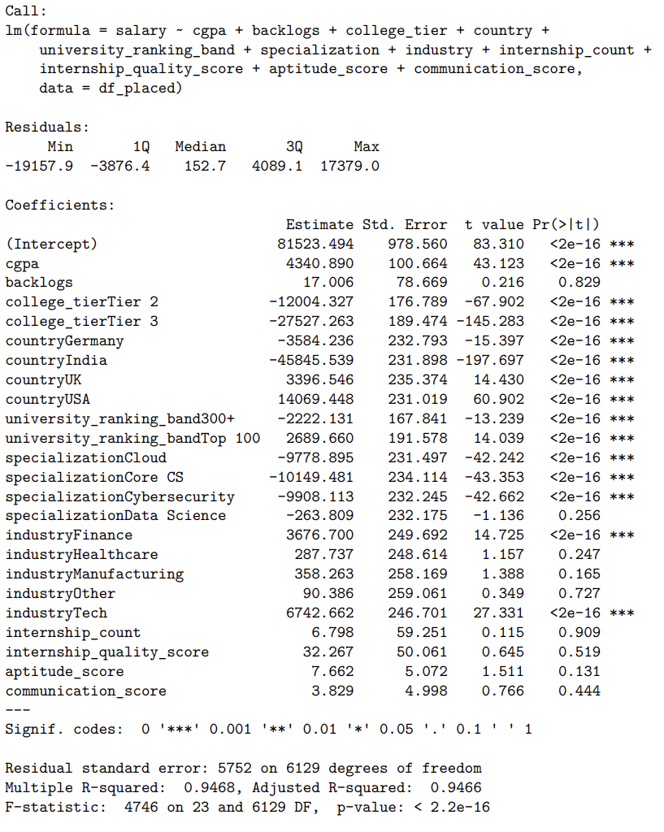
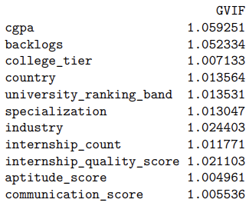
Variable Selection
Student Placement Salary Analysis
Full Model
VIF
All VIF scores were below 5, indicating no severe multicollinearity. We can proceed without removing any predictors for this reason.

Slide 9
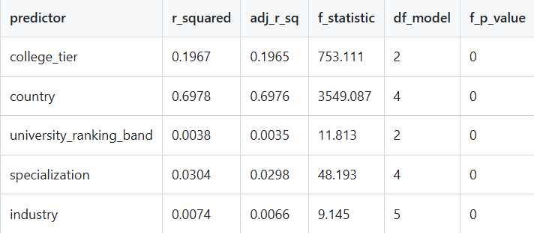
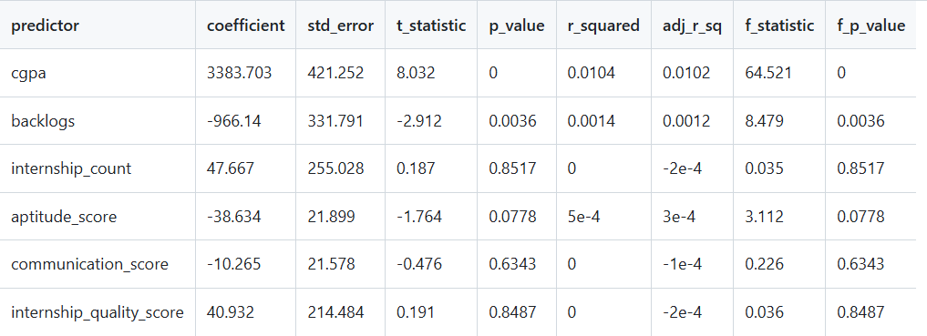
Single-Predictor Regression Screening
Student Placement Salary Analysis
- Ran simple linear regression on each predictor
- Most predictors have low R² individually
- Indicates weak standalone predictive power
- Categorical variables (country, college tier) show stronger effects
- Any value labeled 0 ⁡⁡is <0.001
Removed Variables:
- backlogs
- internship count
- internship quality
- communication score

Slide 10
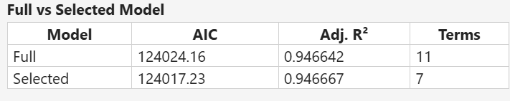
Variable Selection
Student Placement Salary Analysis
Selected model performs essentially the same as full model, but with fewer variables and slightly better AIC / adjusted R².
Removed as low-value after controlling for others: backlogs, internship_count, communication_score, internship_quality_score

Slide 11
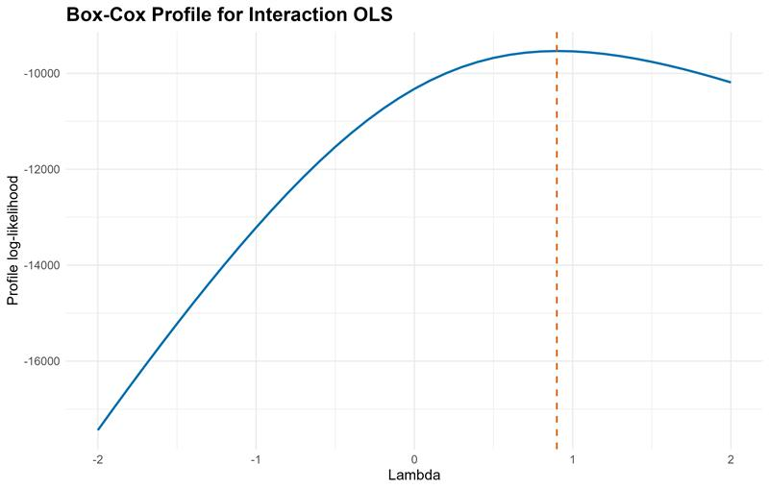
Student Placement Salary Analysis
Model Transformation
Best λ | 0.9
Interpretation | Box-Cox suggests little or no transformation is needed
Note | Arcsine transformation was not tested because salary is not a 0–1 proportion variable

Slide 12
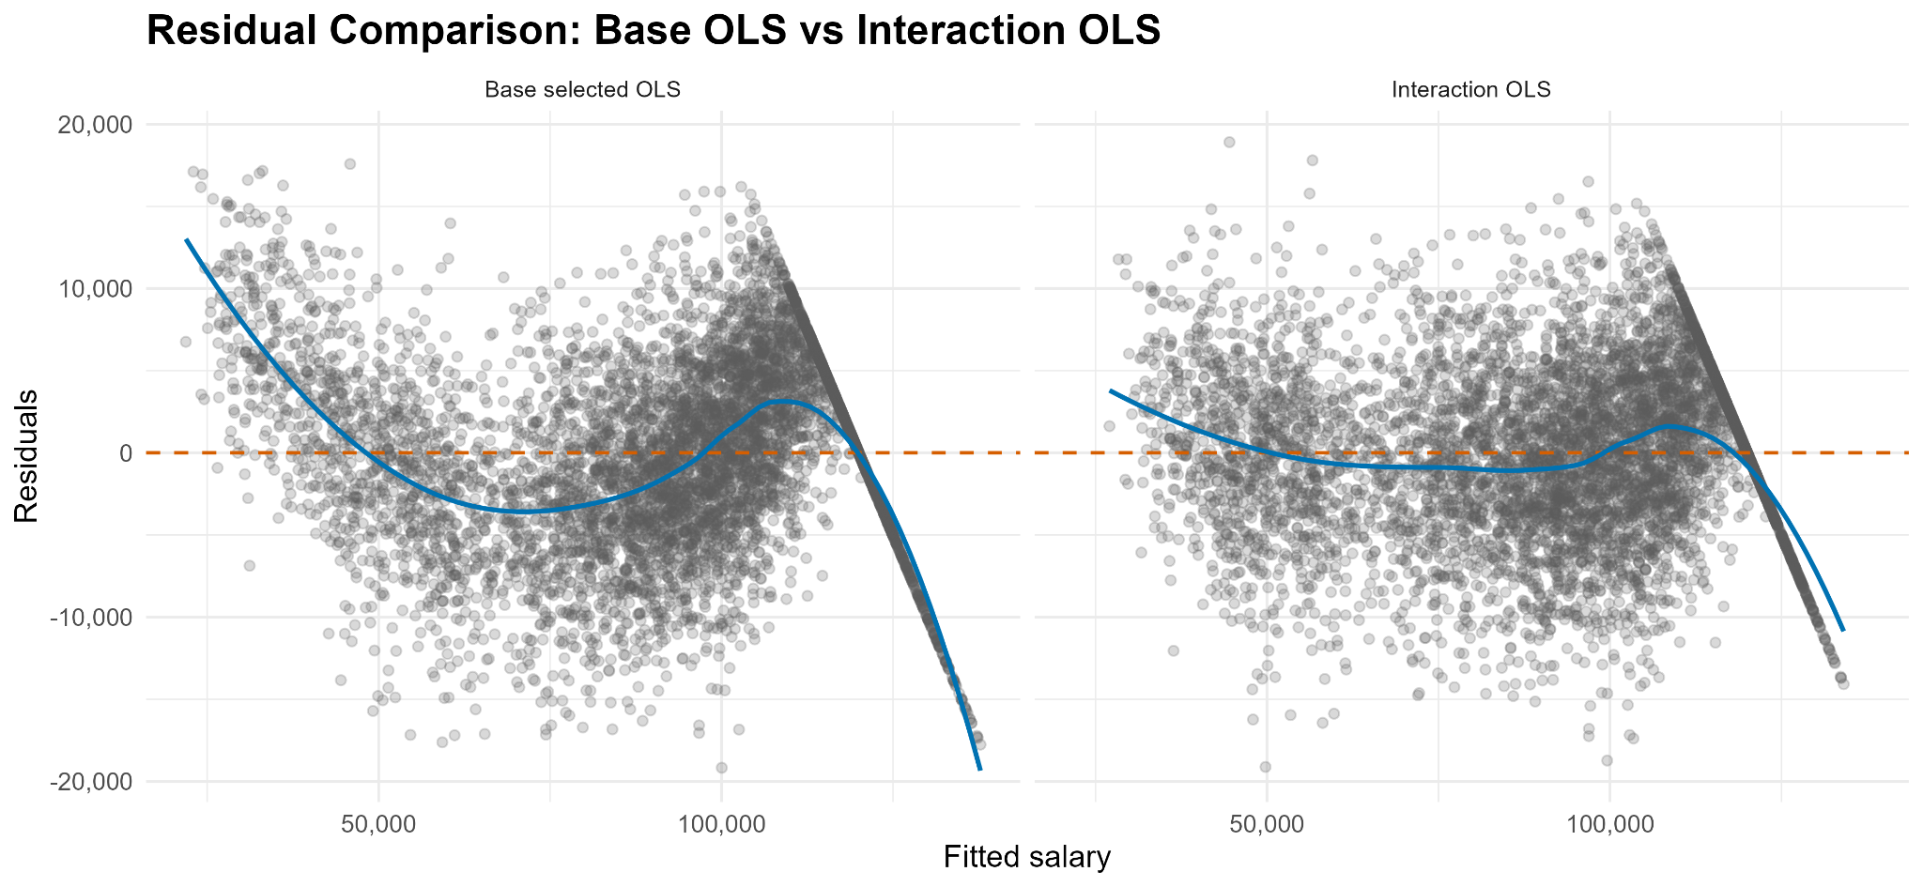
Model Selection
Student Placement Salary Analysis
Base selected OLS model: salary ~ cgpa + aptitude_score + college_tier + country + university_ranking_band + specialization + industry
Interaction OLS model: salary ~ cgpa + aptitude_score + college_tier * country + university_ranking_band + specialization + industry

Slide 13
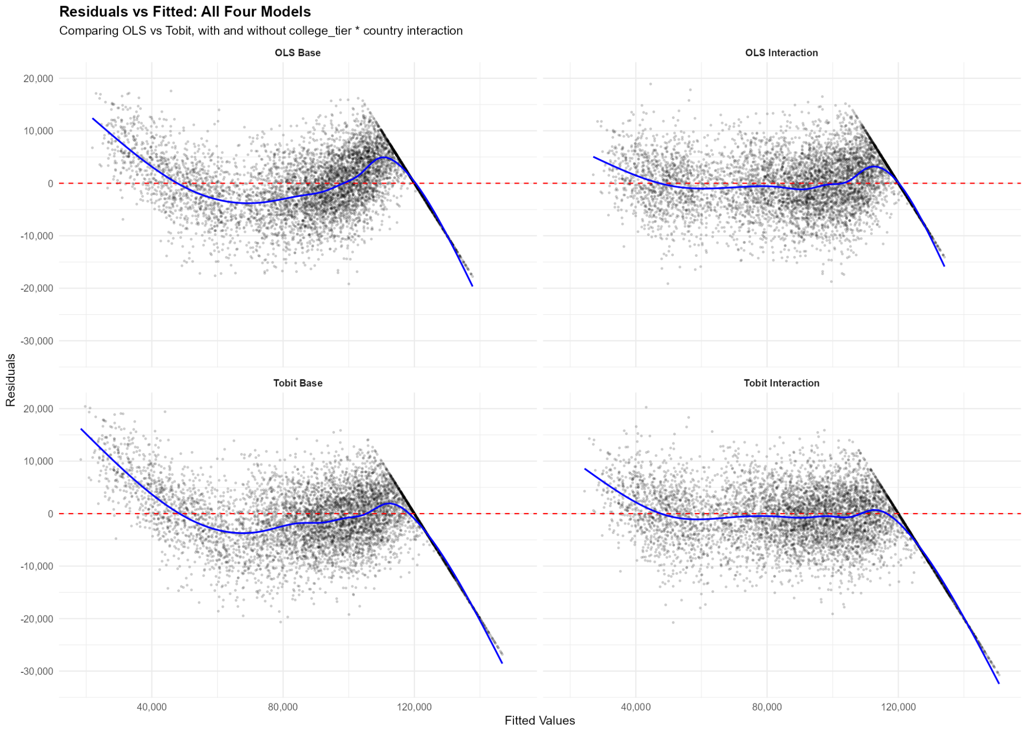
Model Selection
Student Placement Salary Analysis

Slide 14
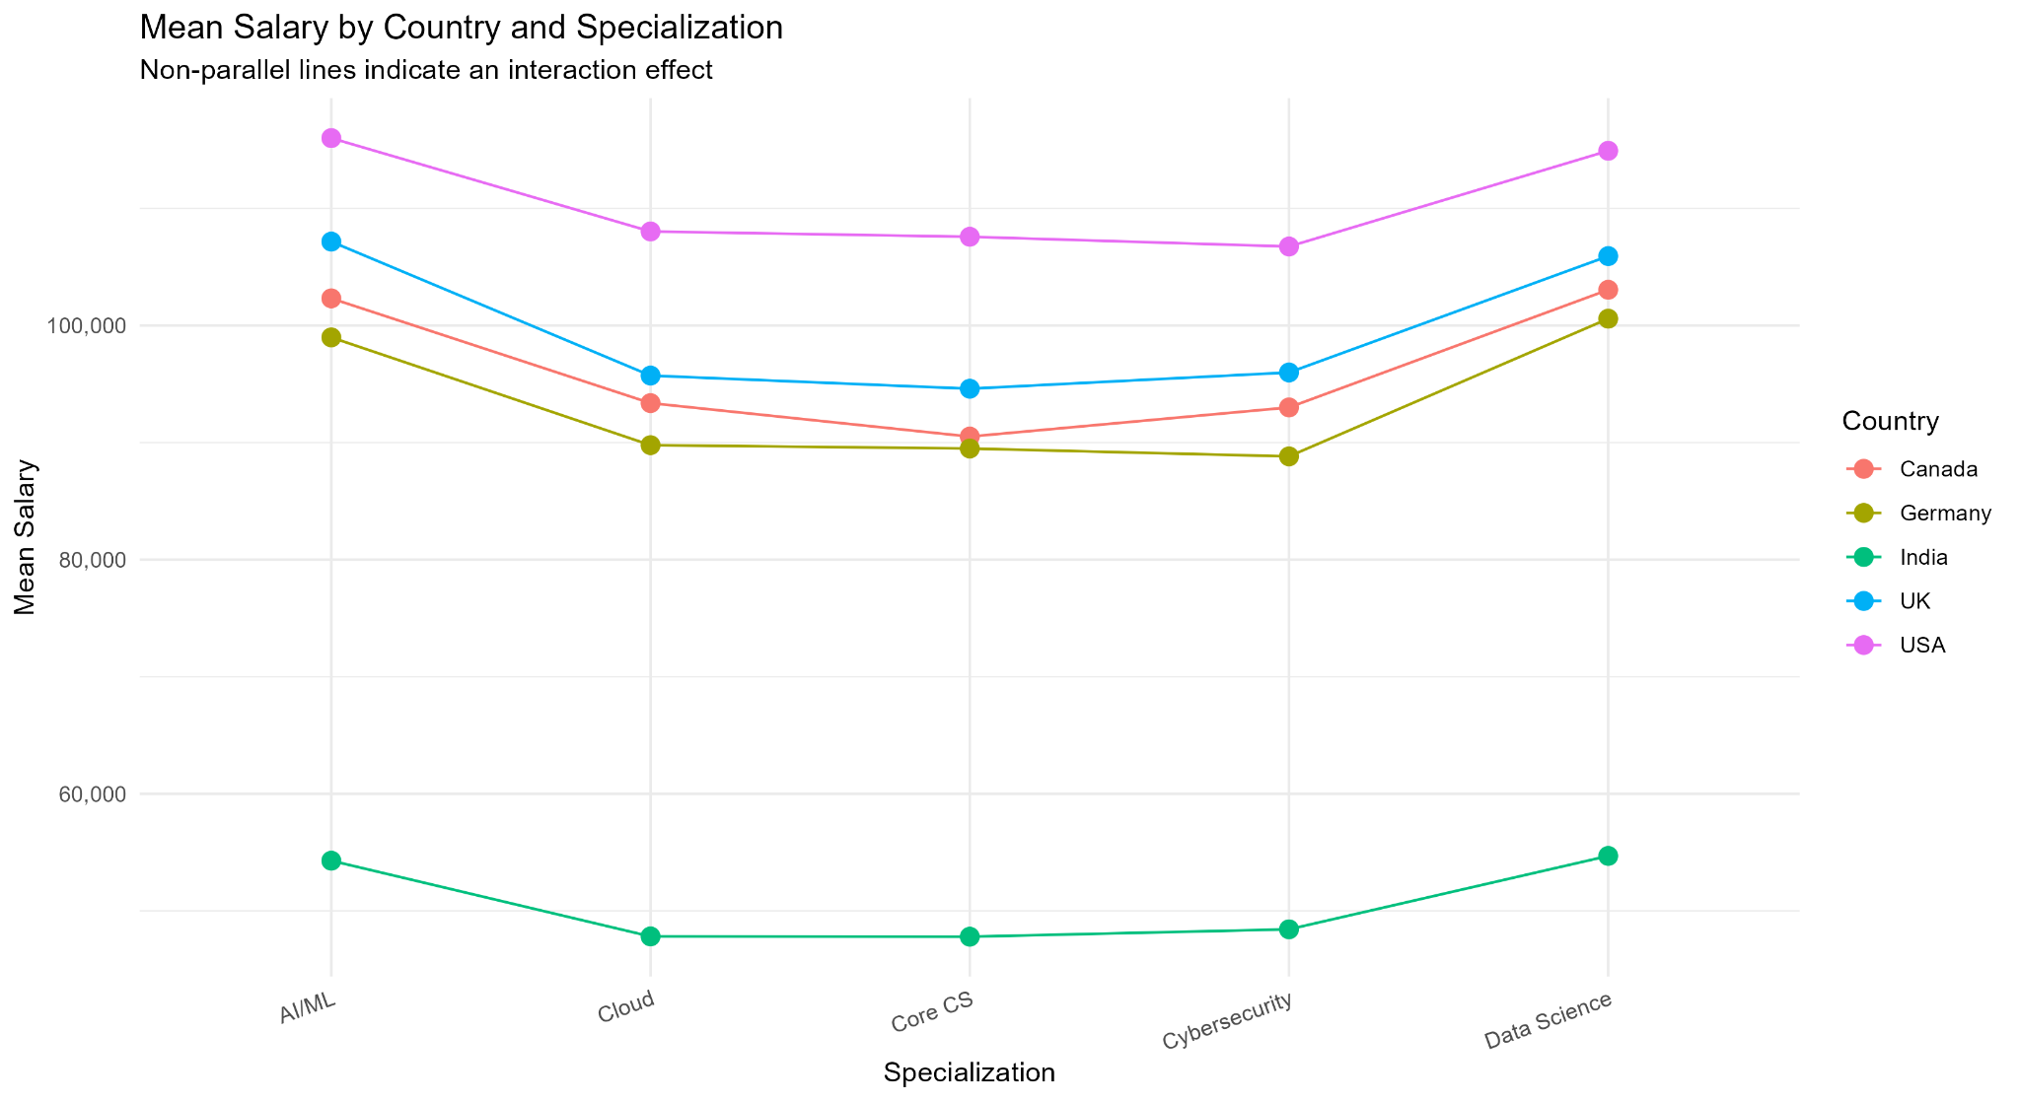
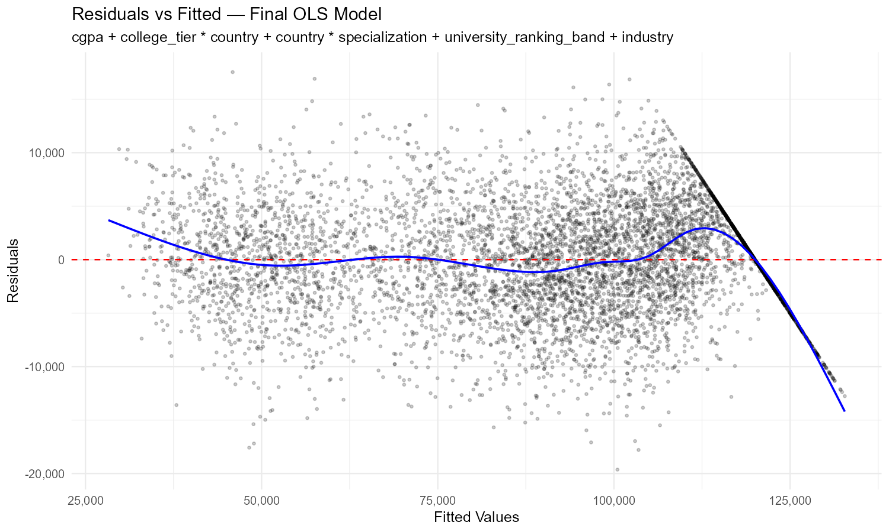
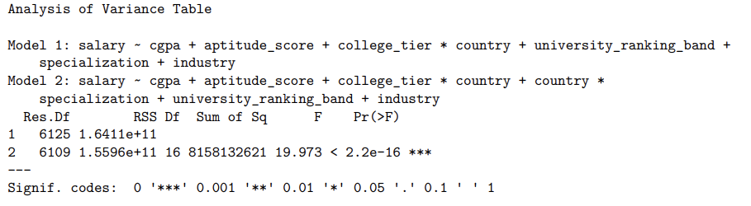
Student Placement Salary Analysis
Model Building

Slide 15
Multiple Regression and Model Selection
Student Placement Salary Analysis
- Fit full model with all predictors
- Used stepwise AIC for model selection
- Compared models using:
- Adjusted R²
- AIC
Model | Predictors Included | AIC | Adj R² | Notes
Full Model | All predictors | 124024.16 | 0.946642 | Baseline comparison
Stepwise Model | cgpa + aptitude_score + college_tier * country + university_ranking_band + specialization + industry | 124017.23 | 0.946667 | Candidate final model
Final Model | cgpa + aptitude_score + college_tier * country + country * specialization + university_ranking_band + industry | 122448.65 | 0.958829 | Selected after diagnostics

Slide 16
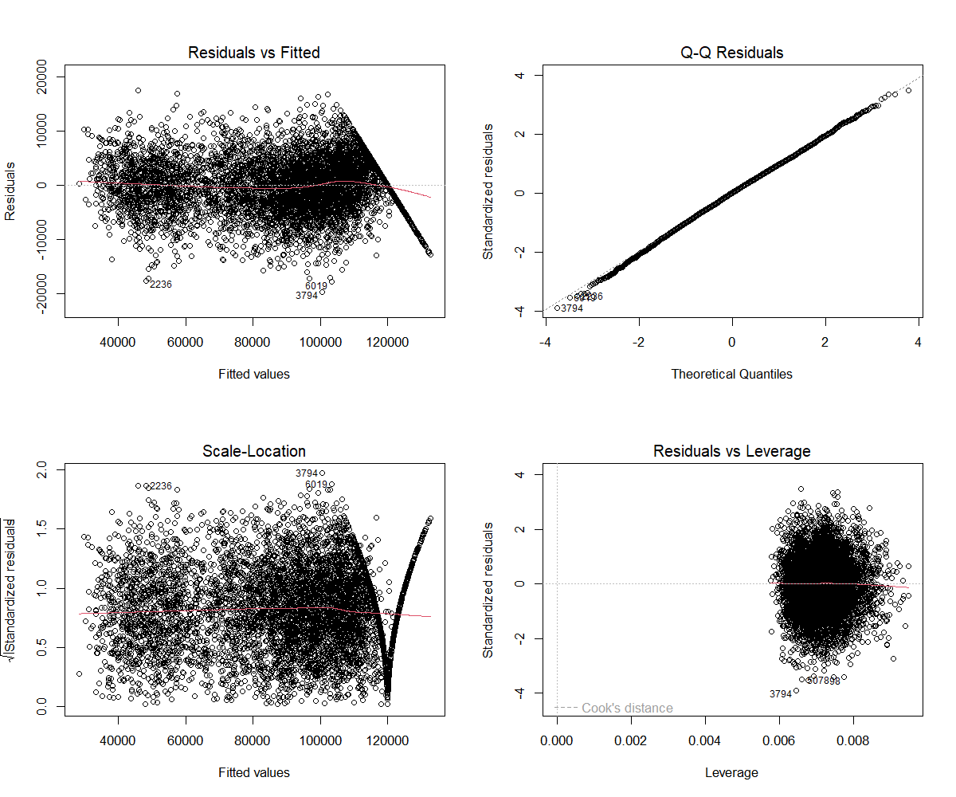
Model Diagnostics & Validation
Student Placement Salary Analysis
Final Model

Slide 17
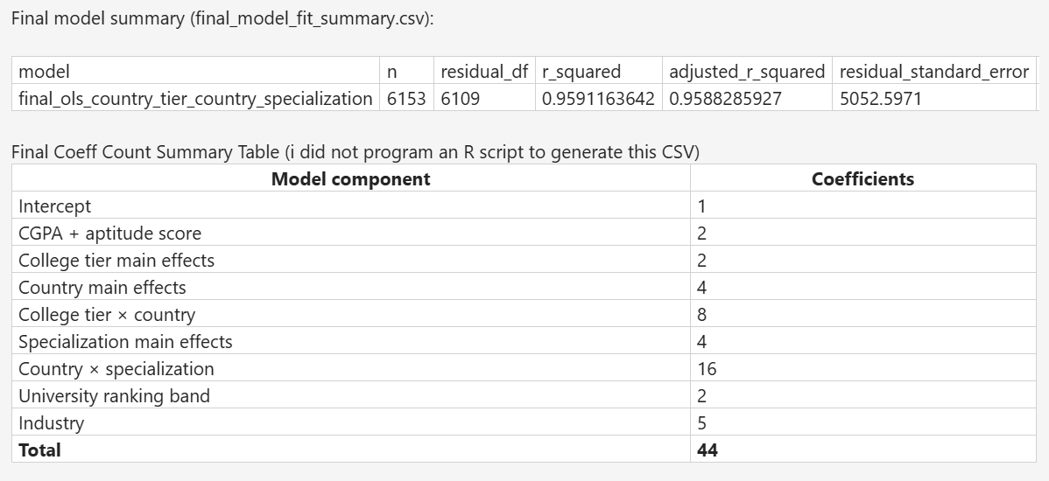
Final Model
Student Placement Salary Analysis

Slide 18
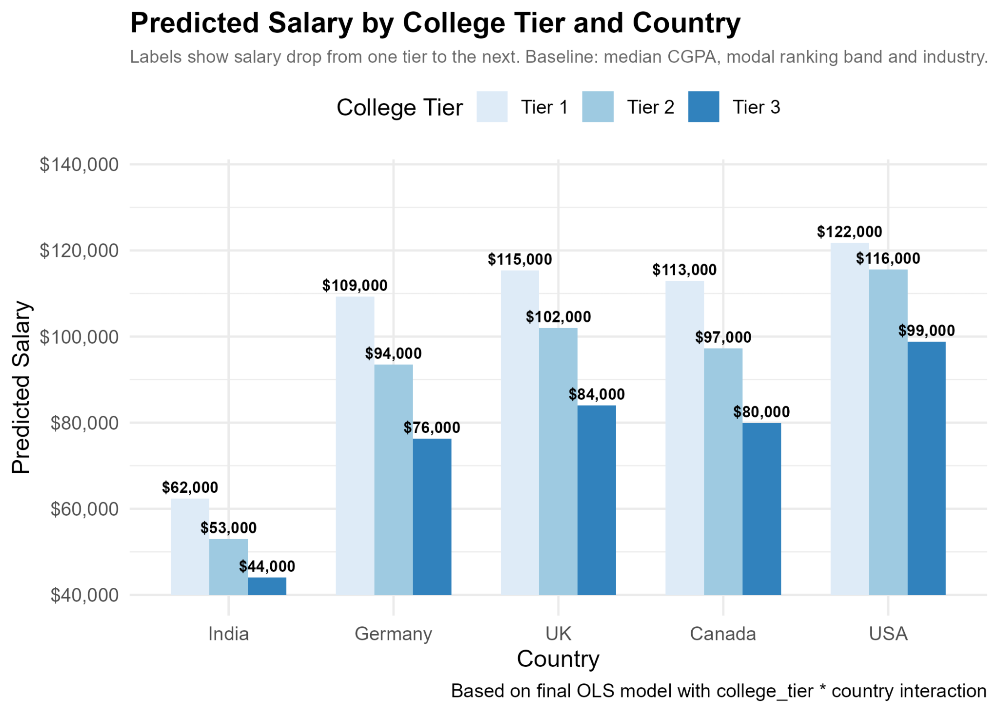
Final Model Interpretation
Student Placement Salary Analysis

Slide 19
Conclusion
Student Placement Salary Analysis
Diagnostics
Conclusion
Future Work
- Strongest predictor:
Country
- Salary influenced more by categorical factors than numeric ones
- Salary cap at 120,000 affects results
- Try log(salary)
- Explore interaction effects
- Analyze by country separately
- Residual vs fitted plot
- QQ plot
- Checked for constant variance
- Checked influential points (Cook’s D, leverage)

Slide 20
Student Placement Salary Analysis
Questions ?
Good Luck on Finals!

